Slide 1




DATA ANALYTICS
CAPSTONE PROJECT
Team 13 - Section Merauke

Slide 2













TEAM 13 - MERAUKE
Siti Nurjanah
Data Cleaning
Dheo Laurenz Purba Data Cleaning
Serlinda Mareta Putri
Data Cleaning
Husein Yarid Zidane
Data Cleaning
Satria Akbar Priatama
Project Leader
Zahra Maharani
Data Analysis
Muh. Ryan Junaedi
Data Analysis
Intan Nur Afwa
Data Analysis
Muhammad Rizky
Data Analysis
Marsa Sawaisabel
Data Visualization
Desi Daomara Sitanggang
Jihan Fadhillah Chaniago
Data Visualization
Sendi Ainur Rokhimah
Data Visualization
Data Visualization

Slide 3

OVERVIEW
Executive Summary
Project Background
issue Tree
Methodology
Data Analysis
Conclusion
Recomendation
Dashboard
Appendix

Slide 4


Project Description
Problem Statement
Tools
Analyzing factors in sales trend fluctuations during December 2020. This project aiming to give some actionable insights which useful for strategic decision-making.
What’s the key factor that influence sales trend across different states?
How to develop strategies to enhance sales in low-performing regions, aiming for a 5% - 10% increase in one year?
Google Sheets, Goole Bigquery Microsoft Power BI.
EXECUTIVE
Analysis Insight
SUMMARY
Recommendation
The land area and climate have no effect on delivery times.
The volume of order is the key for revenue.
Population and income play a significant role for demand and revenue.
Higher price do not impact to demand.
Objective
Build multi-warehouses
Use successful sales strategies
Partnership with local businesses to expand market sales
Reward top-performing salesman
Optimize products to boost low-performing regions.
Increasing sales percentage in states where current sales are below 5%, aiming to achieve a range between 5% to 10%.

Slide 5
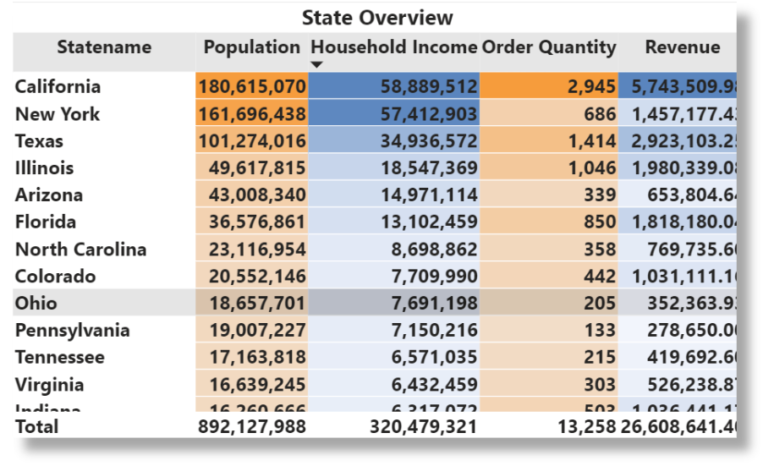


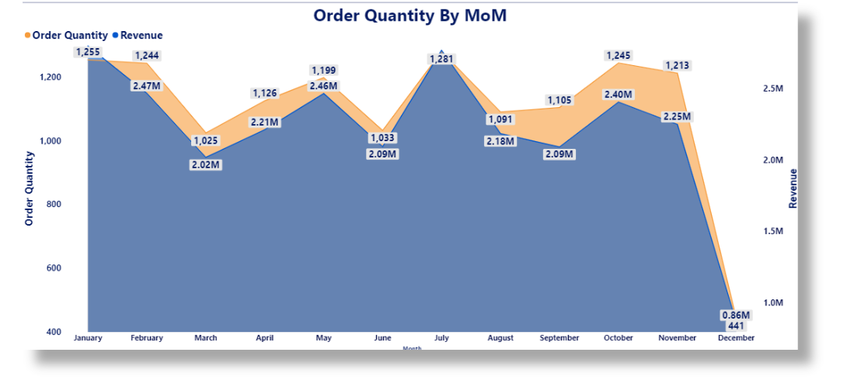
PROJECT BACKGROUND
In 2020 California achieved the highest overall sales approaching 3.000. While other states had sales under than 1.500, even many states are under 500.
An analysis reveals significant drop in December 2020 with many states has reported zero sales, aside the other 5 states has maintained stable performance. The company want to investigate the factors affecting these sales spikes and declines.

Slide 6
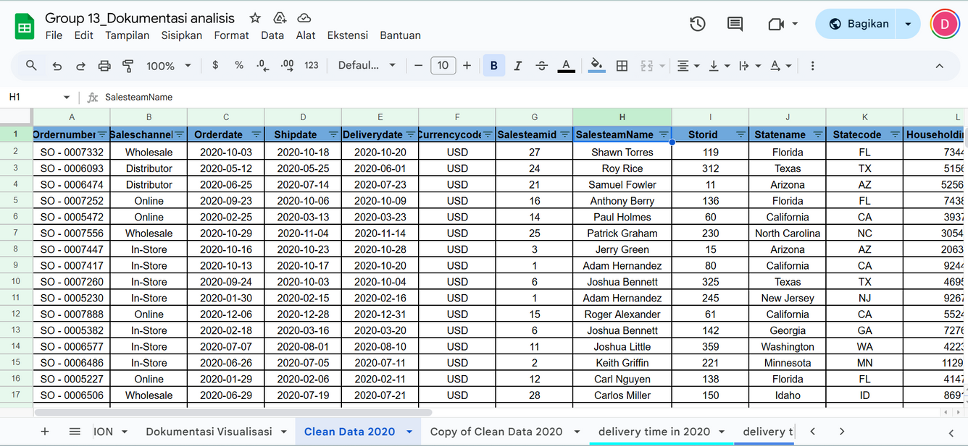
DATASET OVERVIEW
Data Name
US Regional Sales Data
Scope
Focusing on U.S Regional Sales Dataset from January 1st, 2020 - December 31th, 2020. Final data is using 2.959 rows and 22 columns
Column Used
Delivery time, Revenue, Customer Demographics, Product Demand, Sales Performance.

Slide 7
ISSUE TREE
The sales team's performance is not very good
Marketing
Climate and weather affecting product sales
Geographic
The population distribution in each country is uneven
Factors causing the decline and increase in sales across various states
Population
Income
Different household income
The product price is high and limited, which does not align with the high demand
Product
Service
The delivery of goods is too slow

Slide 8
HYPHOTHESIS & VARIABLE
No | Hypothesis | Variable
1. |  | Delivery Time, Total Sales
2. |  | Product Price, Total Sales
3. |  | Population, Total Sales
4. |  | Sales Team, Total Sales
5. |  | Climate and Weather, Total Sales
6. |  | Household Income, Total Sales
If the average delivery time can be sped up, it can increase total sales by 5% - 10% in states experiencing a decline within one year.
If product prices are adjusted to market prices, it can increase total sales by 5% - 10% in states experiencing a decline within one year.
If the population is evenly distributed across all states, it can increase total sales by 5% - 10% in states experiencing a decline within one year.
If the performance of the sales team in each state is improved, it can increase total sales by 5% - 10% in states experiencing a decline within one year.
If the climate and weather in a country support the shipping process, the total sales level will increase by 5% - 10% within one year.
If household income increases in every state, it can increase total sales by 5% - 10% within one year.

Slide 9

METHODOLOGY
1. Understanding
Business Problem
2. Data Cleaning
5. Insight & Recommendation
3. Data Analysis
4. Data Visualization

Slide 10
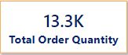
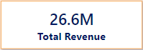
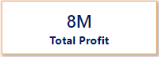
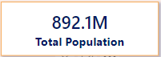
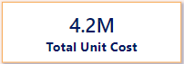
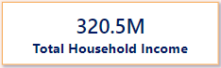
ANALYSIS
Businnes Insight Overview
This visualization explains the company's performance by presenting order quantity, revenue, profit, and unit cost. Additionally, it provides supplementary information on population and household income

Slide 11
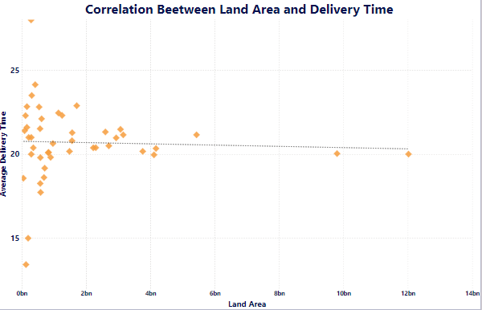
ANALYSIS
Delivery Time
The area and climate of each state do not impact the delivery time of goods.
The dots on the scatter plot are randomly distributed without any clear pattern or trend, indicating that the land area size does not influence delivery time.

Slide 12
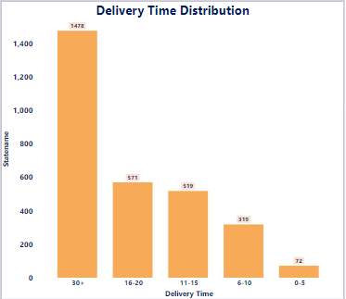
ANALYSIS
Delivery Time Distribution
This chart Explain the distribution of delivery times, where the majority of deliveries take more than 30 days (1,478 deliveries), while the fastest delivery time 0-5 days accounts for only 72 deliveries.

Slide 13
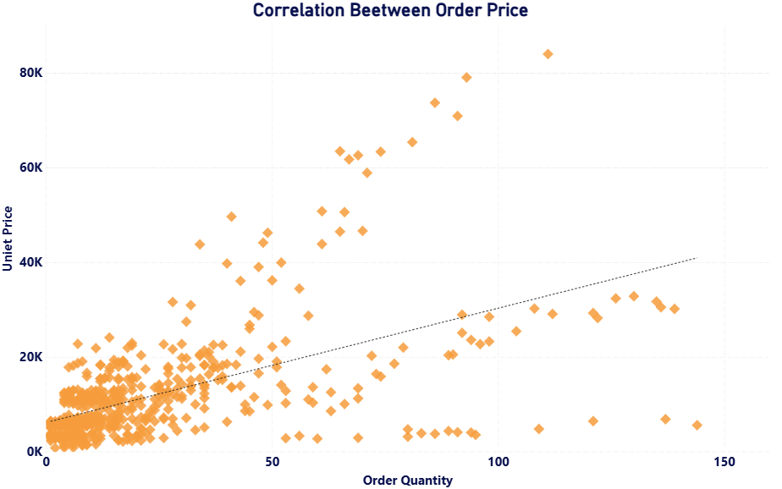
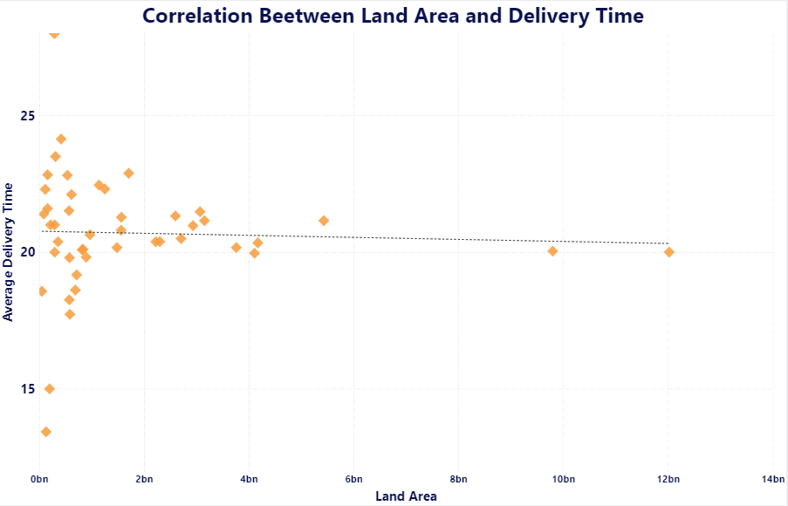
ANALYSIS
Price & Demand
High product prices in each state Fairly influential demand (orders).
Based on the scatter plot, price influences order volume, but it is not the primary factor.

Slide 14
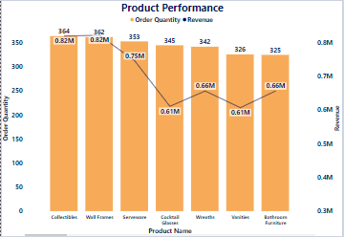
ANALYSIS
Product Performance
The number of orders impacts total revenue.
This chart shows that order quantity impacts the revenue.

Slide 15
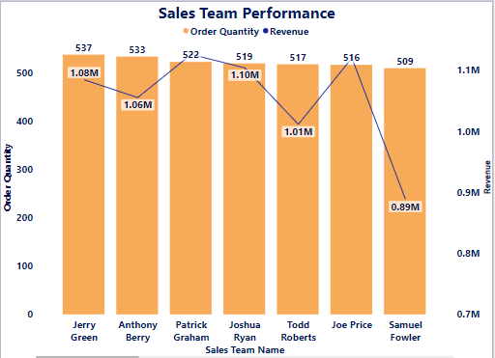
ANALYSIS
Sales Team Performance
The number of orders impacts total revenue and average revenue for each state.
This chart shows that the sales with the highest orders do not necessarily generate the highest revenue

Slide 16
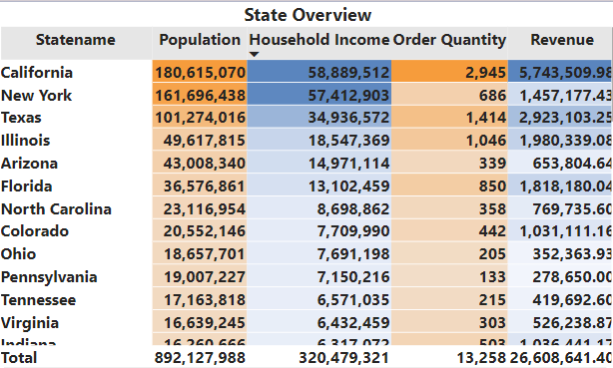
ANALYSIS
Population & Household Income
The population and household income in each state affect both demand of orders and revenue in that state.

Slide 17
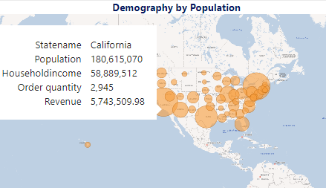
ANALYSIS
Demography by Population
This chart illustrates the demographic distribution grouped by population size. For example, California stands out with the highest population and revenue in 2020 compared to other states.

Slide 18





Delivery time is not affected by area size or climate, highlighting the need for optimized logistics & customized delivery methods for different regions.
The volume of order directly affects revenue; Therefore, the low-performing regions can adopt strategies from high-performing regions to improve their results.
CONCLUSION
Population size & household income both are influence the demand of orders also revenue.
The higher product prices do not significantly affect demand of orders.
Build multiple warehouses, effective sales strategies, and local partnerships are crucial for improving sales in low-performing regions.

Slide 19



RECOMMENDATIONS
1
2
Delivery time
Revenue
Build multi-warehouses in the states and understanding the state's regional areas to better identify the suitable types of shipping for each region.
Countries with lower sales compared to those with higher sales for the same product should adopt the sales strategies of the countries with higher sales.
3
Product & Demand
The most popular items will be produced in larger quantities, while the less popular items will be discounted for clearance.

Slide 20


RECOMMENDATIONS
4
Partnering with local supermarkets, distributors, or online shops to increase product recognition with consument behavior approaches.
Population & Household Income
5
Top-performing salesman can receive bonuses, while lower performers get benefit for training and sharing sessions with high-revenue achievers.
Sales

Slide 21
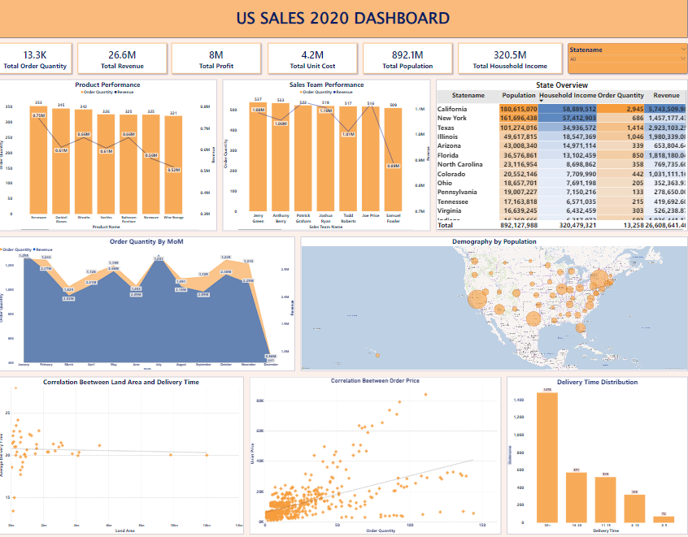
DASHBOARD

Slide 22



APPENDIX
Dataset yang sudah dianalisis
Power BI file
Dataset

Slide 23


THANK YOU
FOR ATTENTIONS
Group 13 - Section Merauke

